Slide 1

FY25 CDBG AH & ED Orientation
Housing and Community Development
Unified Government of Athens-Clarke County
August 15, 2024

Slide 2
Agenda
HCD Department Staff
The Big Picture
Serve our Community and Keep HUD Happy
Review CDBG Application and Deadlines
Staff Contacts
Questions

Slide 3
HCD Department Staff
Management
Melinda Lord, Interim Director
Housing & Economic Development Division
Marqueta Swain, Affordable Housing Administrator
Solomon Smothers, Housing Coordinator
Community Development Division
Marci Irwin, Community Development Administrator
Damario Squire, Community Development Coordinator
Hannah Savard, Community Development Specialist/AH & ED
Lily Sronkoski, Homeless Specialist
Community Impact Division
Compliance Division
Yashu Kavalakuntla, Community Impact Specialist
Alejandra Calva, Community Impact Administrator
Coral Rogers, Compliance Administrator
Santerica Davis, Community Development Specialist- Compliance
Cory Scott, Compliance Analyst
Samantha Gambuti, Community Development Specialist/CD
Michele Tully, Program Support Analyst II- Compliance
Kristen Baskin, Community Impact Specialist
Andrea Livingston, Administrative Assistant

Slide 4

Mission Statement
The Housing and Community Development Department provides funding for the creation and rehabilitation of affordable housing, fosters and coordinates services for disadvantaged populations, and promotes economic mobility among residents of Athens-Clarke County.

Slide 5


The Big Picture
US Legislative Branch makes laws and sets budgets
Housing and Urban Development (HUD) sets parameters and policies for funds
HUD disperses and tracks the funds to participating jurisdictions (PJs)
PJs disperse funds to the community ensuring HUD regulations are followed
Housing and Community Development is a PJ.
HUD classifies our community as an entitlement community. Thus we don’t need to apply for CDBG and HOME funds from HUD every year…as long as we stay in compliance.

Slide 6


Slide 7



Keeping HUD Happy
We keep HUD Happy by spending all the allocated money on eligible activities benefitting eligible individuals and keeping detailed records of that work.

Slide 8
Keeping HUD Happy
Spend All the Money
Your agency’s contract specifies that you are to spend all the money.
It does not help the people we serve, HUD, or our community for us to leave money on the table
Unexpended funds say “we need less entitled funds”

Slide 9
Keeping HUD Happy
2) Eligible Activities
If the expense is not in your agency’s contract budget, we cannot allow it.
When in doubt, call us and ask if it is an eligible expense or activity.

Slide 10
Keeping HUD Happy
3) Benefiting Eligible Individuals
CDBG funds must exclusively be used toward activities that benefit individuals who live in Athens-Clarke County
CDBG funds must exclusively be used toward activities that benefit individuals with documented income at or below 80% of AMI (area median income)
When in doubt, call us and ask about eligible individuals.

Slide 11
Keeping HUD Happy
4) Keeping Detailed Records
Reimbursements
Monthly Reports
Environmental Reviews
Staffing Changes
Client Files
General Admin Files

Slide 12
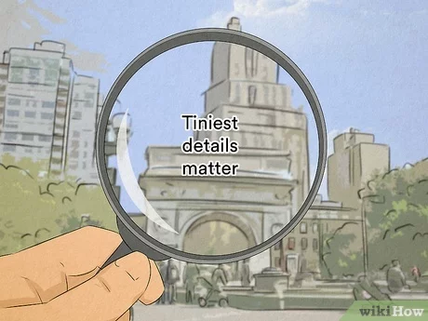

The Details

Slide 13

Reimbursements - The Details
What is a reimbursement?
A reimbursement is a financial document that is submitted by an agency that has been awarded grant funding. A reimbursement includes expenses submitted for payment. All expenses must comply with the grant terms.
Why must we do it?
CDBG Grants are reimbursement based. In order to receive payment, agencies must provide proof of allowable expenses. The bottom line is that we do it this way because HUD says we have to. But also, it’s an efficient process for record keeping.
.

Slide 14
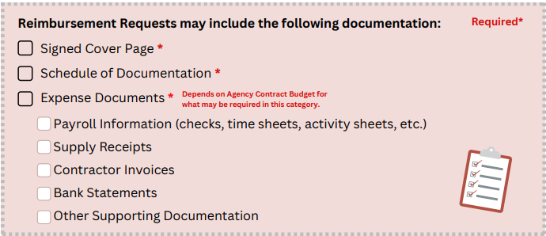
Reimbursements - The Details
Reimbursements are due by the 5th of every month. If the reimbursement is delayed, please contact your Grant Manager by email to let them know.
What’s included in a Reimbursement?

Slide 15
Reimbursements - The Details
Tips for Submitting Accurate Reimbursements
Check your Agency’s contract budget to ensure that expenses are covered before submission.
Make sure all documents are clear and easy to read.
All Time Sheets/Activity Sheets are signed off by the employee’s supervisor.
Make sure all time adds up correctly on time/activity sheets.
Always re-sign the Cover Page when updates are made to the reimbursement.

Slide 16

Monthly Reports - The Details
What is the Monthly Report?
The Monthly Status Report is a document provides monthly updates for the agency’s CDBG program. It helps ensure that the agency is on track to fulfilling their goals & it helps HCD staff with processing reimbursements.
HCD uses the Monthly Report as a guide when processing the reimbursements.
Why are they required?
Well….because HUD says so.
But also, it helps us tell your agency’s story! We use the data in the
Monthly Reports to let HUD and the community know what great work you all
are doing. It also makes reporting & record keeping more efficient.
Due by the 5th of the next month
We cannot process reimbursements without a current Monthly Report.

Slide 17
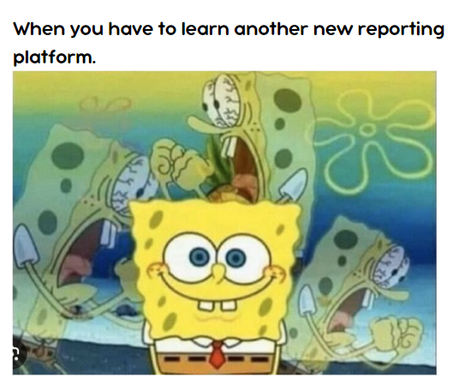

Monthly Reports - The Details
How do I submit the Monthly Report?
The Monthly Status Report will be submitted online through the platform Survey123. Your Grant Manager will provide you with a link for submission.

Slide 18
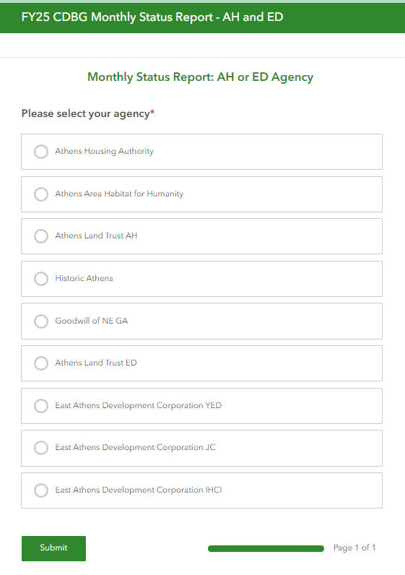
Monthly Reports – The Details
1
Go to the link provided to you by your Grant Manager.
The link should take you to the beginning of the report. You will select your agency.
Finish filling out the report and submit. The report will ask the same questions as it did for the FY24 CDBG reporting period (but includes your FY25 goals).
Digitizing the Monthly Report helps us make sure that our reporting numbers are accurate and allows you to enter the data easily.
2
3

Slide 19
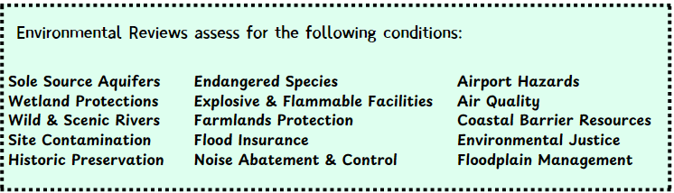
Environmental Reviews -The Details
An Environmental Review is the process of reviewing a project and its potential impacts to determine whether it meets federal, state, and local environmental standards.
HUD mandates that all CDBG projects require an Environmental Review before any Choice Limiting Actions are made.
You might wondering what a Choice Limiting Action is….
A Choice Limiting Action is basically any action or activity that a grantee undertakes expending HUD or non-HUD funds.

Slide 20

Environmental Reviews – The Details
Why do we have to do them?
In short…because HUD says we have to.
But why do they matter & why does HUD say we have to?
Environmental Reviews ensure our community members get a say in what might impact the safety of their homes. Additionally, though grant funding helps many people in our community, we want to make sure the Environment gets a chance to tell its story too. We don’t want to do anything that may harm the environment and that may one day negatively impact our community members.
Examples of Why they matter:
Before NEPA in 1970, federal funding was being utilized to support installation of infrastructure that supported racial segregation in predominantly African American neighborhoods. Environmental Reviews were implemented in NEPA to prioritize community health and safety by involving the public and ensuring transparency and accountability for governments using federal funding.
Lummi Tribe of Washington State was able to preserve and protect their land and fishing rights when proposed development of a coal export terminal threatened them.
How long are Environmental Reviews good for?
5 Years. However if the Scope of Work changes, the Environmental Review will require an amendment.
Notes:
https://www.momscleanairforce.org/moms-oppose-weakening-nepa/

Slide 21

Environmental Reviews – The Details
How do I submit a project for Environmental Review?
Email Solomon Smothers (Solomon.smothers@accgov.com) and Hannah Savard (Hannah.Savard@accgov.com).
Project Information should include the following:
A Scope of Work that includes the activities of the ENTIRE project. Not just what CDBG funds will cover.
Please include any activities that may cause ground disturbance.
Whether the project will be a single family (1-4 units), Multifamily (5+ units), or Other.
If there will be additions or removal to any landscape.
If New Construction, please include the square footage, building plans, Elevation
and Site Plans, and/or Landscape Plans.

Slide 22

Environmental Reviews – The Details
If submitting pictures, please include pictures of the front, sides, & back of the home + any structures on the property (i.e. sheds).
How much the project will cost.
If the project costs more than $5,000.00 & it’s a rehabilitation, Lead Based Paint standards will be triggered. Please be as concise as possible.
If there is an increase in housing density for the project, please submit the details.
If submitting pictures, please include pictures of the front, sides, & back of the home + any structures on the property (i.e. sheds).
HCD can take pictures of the Area of Potential Effect, but if agency staff happens to already have the pictures, you can submit pictures of any neighbors (beside, behind, across the street).

Slide 23

Staff Changes - The Details
When staff changes occur to employees who participate in the CDBG program (promotions, turnover, pay raises, etc.), please notify your Grant Manager of these changes.
HUD sees fluctuations in key positions as markers of instability. The sooner we know the sooner we can ensure that the new person is primed for success.
Knowing of these changes can also assist us in processing reimbursements faster.

Slide 24

Record Keeping - The Details
The following files should be up to date and readily available:
Contracts
Client Files
Financial Records
Timely Reports
Staffing Changes
Policies and Procedures
General Admin Files:

Slide 25
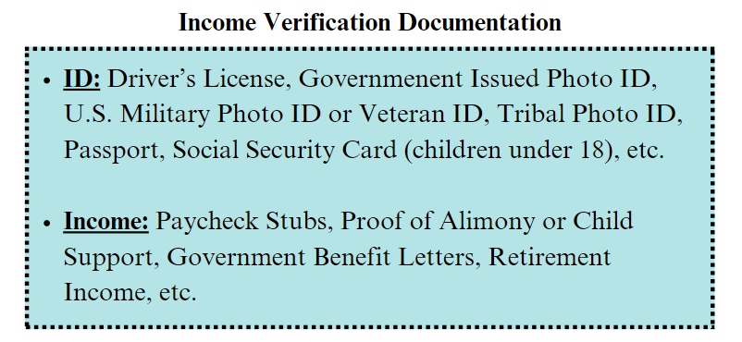
Income Verification - The Details
Income Limits are limits on a person’s income set by HUD or another funding agency to determine if a person meets the criteria to receive services or assistance from a program.

Slide 26
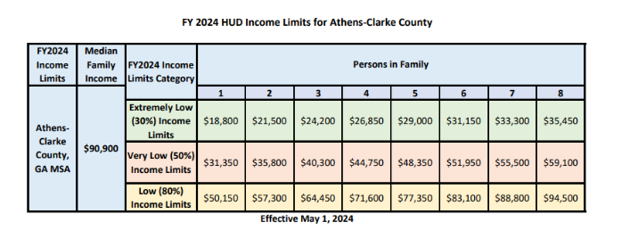
Income Verification – The Details

Slide 27

General Admin Files - The Details
Active Board List: Please notify us of any Board member changes.
Financial Information (Tax Documents, Audits, etc.): HUD requires us to keep updated yearly financial records. Please be timely in submitting them.
UEID Number: Please keep your UEID number valid and up to date.
Agency Insurance: Keep copies of all insurance documentation and notify HCD if any of these details change.

Slide 28

Key Dates
FY26 CDBG Release Meeting October 17, 2024
Notice of Intent Due October 25, 2024 at midnight (12:00am)
CDBG Applications Due November 18, 2024 at midnight (12:00am)
Mayor & Commission Work Session March 11, 2025
Agenda Setting Meeting April 15, 2025
Mayor and Commission Voting Meeting May 6, 2025
Initiate Contracting May 7, 2025*
FY26 CDBG Funding Available July 1, 2025
*Dependent upon HUD notification of CDBG and HOME funding allocations

Slide 29



Technical Assistance
HCD Office: (706) 613-3155
Affordable Housing and Economic Development
Marqueta Swain, marqueta.swain@accgov.com, ext. 6026
Solomon Smothers, solomon.smothers@accgov.com, ext. 6016
Hannah Savard, hannah.savard@accgov.com, ext. 6017
Remember…when in doubt reach out!

Slide 30

Questions?

