Slide 1

CDBG Application Release Meeting
Consolidated Plan: July 1, 2025 - June 30, 2030
Action Plan I: July 1, 2025- June 30, 2026
Housing and Community Development
Unified Government of Athens-Clarke County
October 17, 2024

Slide 2

Agenda
HCD Department Staff and Mission Statement
Review the Consolidated Plan
Present Goals and Objectives
Review CDBG Application and Deadlines
Decision-Making Schedule
Staff Contacts
Questions

Slide 3
HCD Department Staff
Management
Melinda Lord
Housing & Economic Development Division
Marqueta Swain
Solomon Smothers Housing Coordinator
Community Development Division
Marci Irwin
Damario Squire Community Development Coordinator
Hannah Savard Community Development Specialist/AHED
Lily Sronkoski Community Development Specialist /CoC
Community Impact Division
Compliance Division
Alejandra Calva, Community Impact Administrator
Coral Rogers
Michele Tully
Andrea Livingston Administrative Assistant II
Samantha Gambuti Community Development Specialist/CD
Santerica Davis Community Development Specialist/Compliance
Cory Scott
Yashu Kavalakuntla Community Impact Specialist
(Vacant)
Acting Director
Affordable Housing Administrator
Community Development Administrator
Community Impact Specialist
Compliance Analyst
Compliance Administrator
Program Support Analyst II
(Vacant)
Community Development Specialist/Lead Hazard Reduction

Slide 4

Mission Statement
The Housing and Community Development Department provides funding for the creation and rehabilitation of affordable housing, fosters and coordinates services for disadvantaged populations, and promotes economic mobility among residents of Athens-Clarke County.

Slide 5
Consolidated Plan
Strategic Planning Process
The Consolidated Plan:
A 5-year plan with goals, a strategic plan and an annual action plan for the use of CDBG, HOME and CoC homeless assistance funds.
The Consolidated Plan supports:
Safe, stable and affordable housing
Expanded economic opportunities
Suitable living environment for persons of low and moderate income
Funding will be available July 1, 2025

Slide 6
The Consolidated Plan Process: Goals
The approved FY26-30 ConPlan Goals will determine eligible CDBG and HOME programmatic activities for July 1, 2025 through June 30, 2030.
September 6, 2024 and October 17, 2024: HCD will release FY26 HOME and CDBG funding for Annual Action Plan I, which covers the performance period of July 1, 2025 through June 30, 2026.
Because of the release date of FY26 funds, the FY26-30 ConPlan Goals must be approved prior to completion of the full ConPlan.
HCD conducted several public meetings to provide residents the opportunity to share input and ideas on the proposed FY26-30 ConPlan Goals.
HCD made the proposed goals available online from May 31 through June 23, 2024 for review and public feedback opportunities, especially for anyone unable to attend the public input meetings.
A critical component of the FY26-30 ConPlan development process is to determine priority needs and specific goals that will guide eligible project funding determinations for Annual Action Plans I-V.
Notes:
Approved FY26-30 ConPlan Goals are required for release of the FY26 HOME and CDBG applications, which will occur on September 6th and October 17, 2024, respectively. As a result, HCD has developed it’s proposed goals primarily based on the Athens Affordable Housing Investment Strategy, the Athens Strategic Plan to Reduce and Prevent Homelessness, the ACCGov FY23-25 Strategic Plan, and other relevant community strategic plans.
The FY26-30 proposed goals were made available to the public from May 31, 2024 through June 23, 2024, and the public was notified of availability to review the plan and of public review meetings on May 31st via NewsFlash notification, extensive agency Listserv email, and through the Neighborhood Leaders program. On June 5th, HCD posted notification of meetings and availability to review the plan in the Athens Banner Herald. Anyone unable to attend a scheduled public meeting was strongly encouraged to submit their comments through email or phone to HCD staff.
6

Slide 7
Citizen Participation Process
May 31 - June 23, 2024: Four community meetings to identify and provide feedback on proposed Goals
August 2024: Mayor and Commission reviewed Goals and Objectives
September 2024: Mayor and Commission approved Goals
October 2024 – May 2025: Continued development of the Consolidated Plan

Slide 8
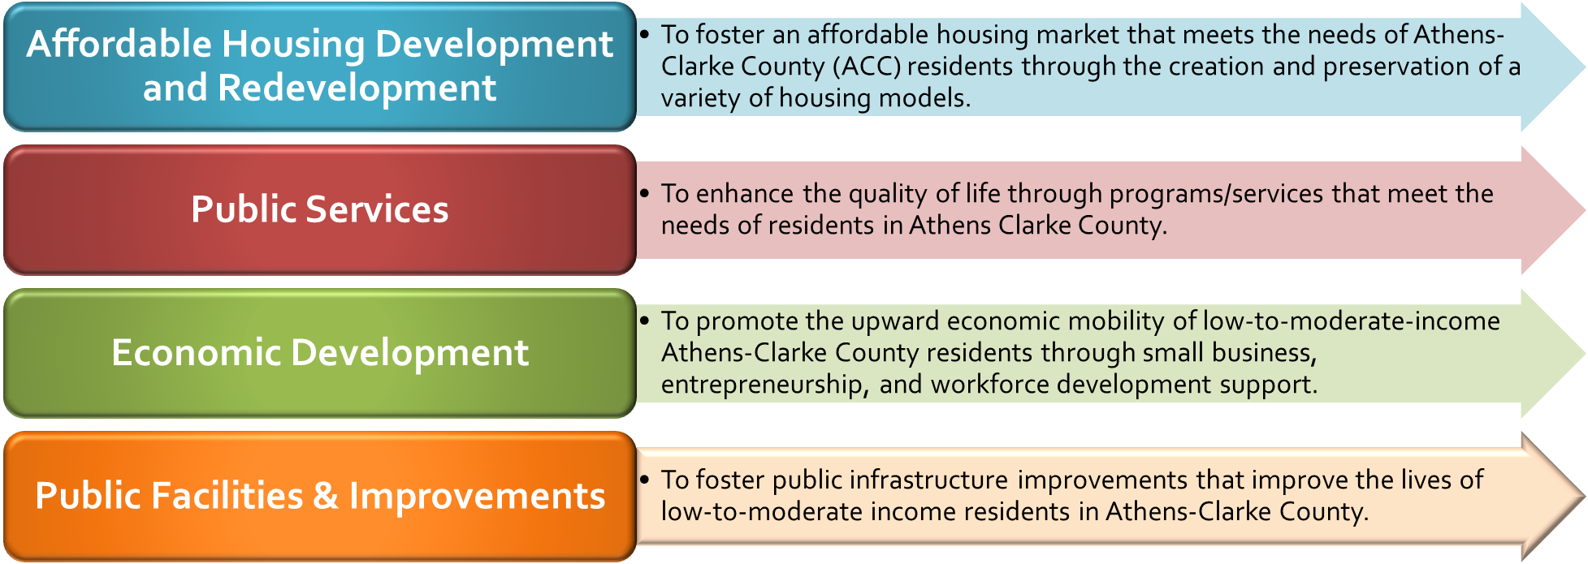
FY26-30 ConPlan Goals
Notes:
The proposed FY26-30 ConPlan Goals, listed in order of priority, include Affordable Housing Development and Redevelopment, Public Services, Economic Development and Public Facilities & Improvements. Each goal has strategies to support activities eligible for CDBG and HOME entitlement funding. These strategically focused and narrowed goals target high-needs activities to more effectively maximize the impact in our community. Prioritization of projects is key to successfully reducing poverty and to meeting the needs of the LMI community more efficiently and successfully.
8

Slide 9

Consolidated Plan Goals
Goal 1: Affordable Housing Development and Redevelopment
    To foster an affordable housing market that meets the needs of Athens-Clarke County (ACC) residents through the creation and preservation of a variety of housing models.
Contact Marqueta Swain, Solomon Smothers, or Hannah Savard if you are applying for affordable housing activities.

Slide 10
Affordable Housing Development and Redevelopment Goal Strategies
Strategy
HOME, CDBG (To support HOME Operations)
  Increase access to affordable housing through the development of quality affordable rental units by supporting LIHTC or other projects that create multi-family affordable housing units, which may include mixed-income and mixed-use developments.
Strategy
CDBG and HOME
  Target challenged multi-family developments for major redevelopment and preserve and develop the affordability of existing rental homes while improving their quality.
Strategy
HOME, CDBG (Direct service and/or to support HOME Operations)
  Promote low-to-moderate household homeownership through new construction or rehabilitation of affordable homebuyer single-family units and through increased homebuyer down payment assistance.
Strategy
CDBG
  Expand low-to-moderate household homeowner occupied rehabilitation projects through increased minimum per-project funding.
Strategy
CDBG (As a Public Service)
  Support training and counseling opportunities for homebuyer and downpayment assistance program participants.
Strategy
CDBG and HOME (As a Planning & Admin Activity by HCD Staff)
  Increase fair housing education and outreach to ensure tenants understand and can communicate their rights and responsibilities.

Slide 11

Consolidated Plan Goals
Goal 2: Economic Development and Workforce Development
    To promote the upward economic mobility of low and moderate income Athens-Clarke County residents through small business, entrepreneurship, and workforce development support
Contact Marqueta Swain, Solomon Smothers or Hannah Savard before the Friday, November 9th deadline if applying for economic development activities.

Slide 12
Economic Development Goal Strategies
Strategy
CDBG
  Create incentives to encourage revitalization of neighborhoods and commercial developments
Strategy
CDBG
  Provide the facilities and services necessary to attract, incubate, and grow businesses across a variety of sectors.
Strategy
CDBG
  Provide business planning assistance, technical assistance, and business support services to start-ups and owners of microenterprises.
Strategy
CDBG
  Provide financing assistance for small businesses to expand economic opportunities.
Strategy
CDBG (As a CBDO Public Service)
  Promote workforce development through ESL programs, GED programs, youth apprenticeship programs, vocational training, and job placement.
  Provide financial literacy training and promote financial stability of low-and moderate-income households.

Slide 13

Consolidated Plan Goals
Goal 3: Public Services
  To enhance the quality of life through programs/service that meet the needs of residents in Athens Clarke County.
Contact Damario Squire, Lily Sronkoski or Samantha Gambuti if applying for public services activities.

Slide 14
Public Services Goal Strategies
Strategy
CDBG
  Homelessness (Individuals and Families):
    Comprehensive street outreach services
    Low-barrier emergency shelter
    Diversion and rapid exit programming
    Supportive services
    Expansion of the affordable housing market through landlord engagement programs
Strategy
CDBG
  Youth Development and Violence Prevention:
    Educate, train and develop young people in Athens-Clarke County so that they will graduate from high school prepared to successfully enter the workforce, continue their education and/or enlist in armed forces to better reach their full potential
    Support the development of youth literacy, math, science, social and emotional learning (SEL) skills, and build stronger connections that lead to societal contributions
    Develop and expand youth development programming that is accessible and equitable.
    Expand youth development programs for public safety
    Provide opportunities for students to be exposed to, and interact with local, hybrid or remote career options.
Strategy
CDBG
  Provide supportive services for eligible low-to-moderate income individuals in support of affordable housing, economic development, and public facilities and improvements goal driven activities.

Slide 15

Consolidated Plan Goals
Goal 4: Public Facilities & Improvements
  To foster public infrastructure improvements that improve the lives of low and moderate income residents in Athens-Clarke County.
If applying for Public Facilities & Improvements funding, please speak with
Marci Irwin no later than Friday, November 1, 2024.

Slide 16
Public Facilities and Improvements Goal Strategies
Strategy
CDBG
  Improve facilities for persons with special needs such as facilities for individuals experiencing homelessness, domestic violence shelters, nursing homes, assisted living for individuals with disabilities, or mental health facilities.
Strategy
CDBG
  Improve parks, community centers, sidewalks or other public infrastructure that increase livability, safety, and accessibility for residents in high poverty concentration areas.

Slide 17
FY26 CDBG Application Release for Funding
Athens-Clarke County
Community Development Block Grant (CDBG)
July 1, 2025 – June 30, 2026
Grant funding is distributed on a reimbursable basis.
Final funding decisions are made by the Mayor and Commission

Slide 18
Estimated FY26 CDBG
*Approximately $1,210,965 in FY26 CDBG funding will be available for affordable housing, economic development, public facilities, and public service activities.
*The FY26 estimated CDBG award is based off FY25 award amounts.
Total funding availability may increase or decrease based on the actual HUD FY26 award allocation.

Slide 19

FY26 CDBG Eligibility
The Application Instructions provide detailed guidance for CDBG application eligibility, including HCD Con Plan goal activities and National Objectives that qualify for funding. Please reference it, or ask HCD staff for guidance, to ensure your proposal meets the necessary criteria.
If your program addresses a Consolidated Plan Goal and National Objective, it is eligible for CDBG funding consideration.
If your application includes all of the required information and correct attachments, your program is eligible for CDBG funding consideration.
If your Notice of Intent is submitted by the October 25, 2024 midnight (12:00am) deadline, your agency is eligible to complete the FY26 CDBG application.
If your application is submitted in ZoomGrants by the midnight (12:00am) deadline on November 18, 2024, your program is eligible for CDBG funding consideration.

Slide 20

Public Service
Program Eligibility
Minimum grant award of $30,000;
25% cash match requirement;
Agencies applying for homeless services funding must participate in the Athens Homeless Coordinated Entry System, a HUD requirement;
Agencies applying for homeless services must participate in the local Homeless Management Information System (HMIS), a federally mandated homelessness reporting system;
Renewal funding recommendations are contingent upon annual assessment of successful performance and expenditures.

Slide 21
Notice of Intent to Apply
If you are considering submitting a CDBG application for funding, please complete the mandatory CDBG Notice of Intent (NOI) to Apply for each program/project.
The CDBG Notice of Intent to Apply must be completed in ZoomGrants no later than
midnight (12:00am) on October 25, 2024.
As stated before, if you plan to seek funding for more than one project or program, a separate application NOI should be completed for each individual proposal.
Please do not combine NOIs for multiple activities.
Completing the NOI will assist HCD in planning our comprehensive technical assistance program that ends
November 1, 2024.
HCD cannot guarantee staff availability after that date.

Slide 22
ZoomGrants and the FY26 CDBG Application
All FY26 CDBG applicants MUST start the application process by going to the following link:
FY26 CDBG Application Link

Slide 23
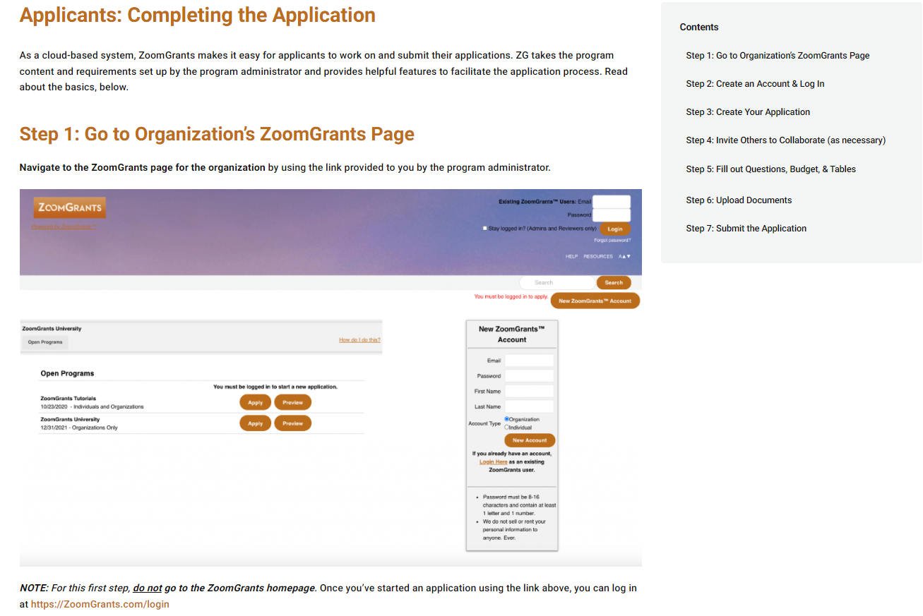
Apply Using ZoomGrants

Slide 24
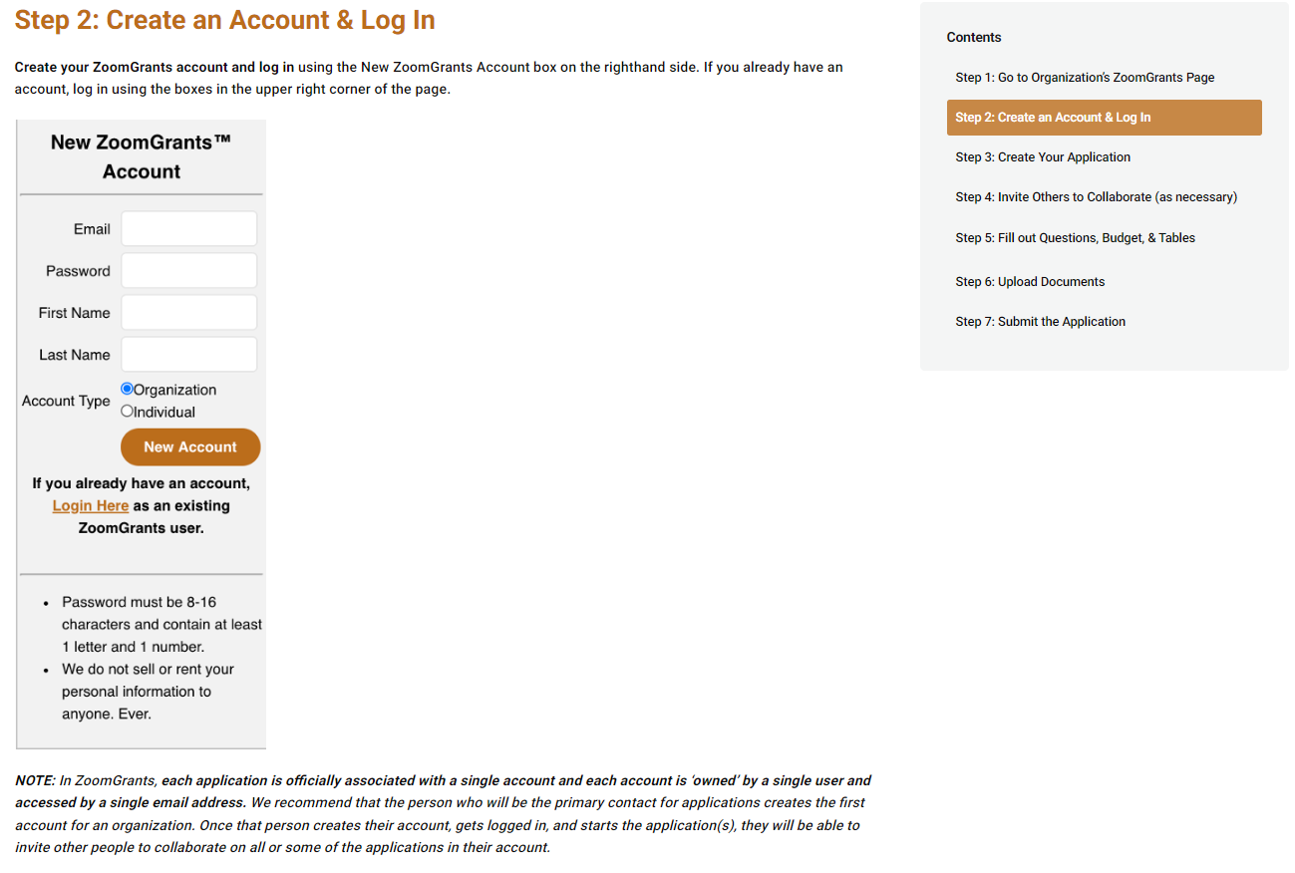
Apply Using ZoomGrants (cont.)

Slide 25
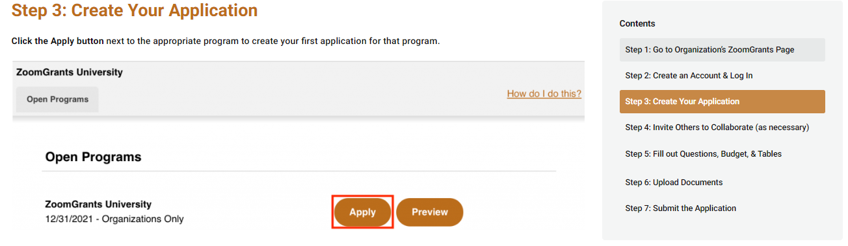
Apply Using ZoomGrants (cont.)
IMPORTANT NOTE:
If you plan to apply for multiple programs, you must complete this step for each one.

Slide 26
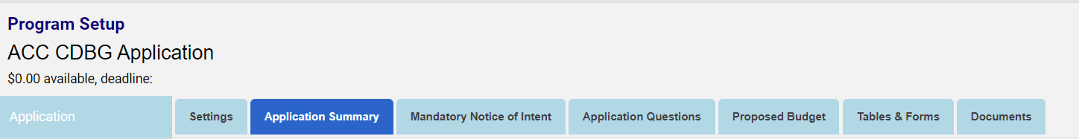
Apply Using ZoomGrants (cont.)
After you’ve created a new application, complete the Application Summary tab and the Mandatory Notice of Intent (NOI) tab.
REMINDER:
A separate application should be created for each program/project, and the NOI should be specific to the individual application.

Slide 27
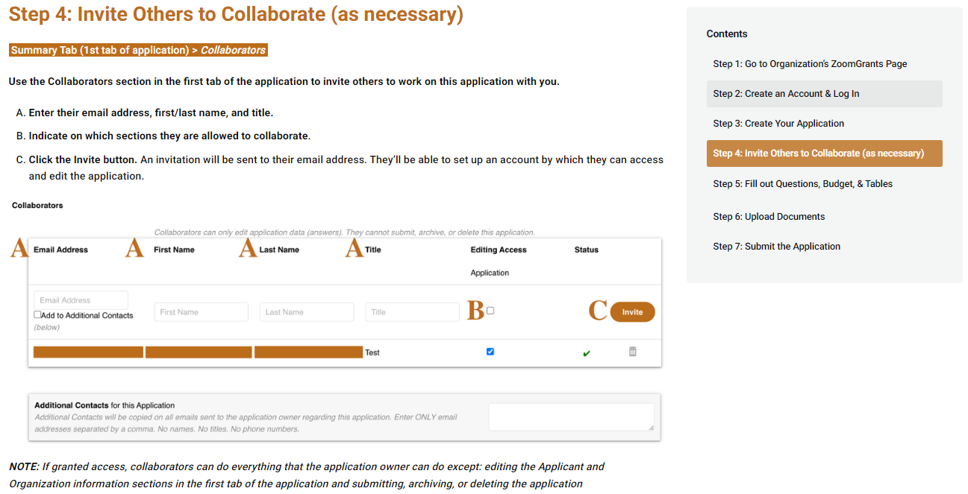
Apply Using ZoomGrants (cont.)

Slide 28
ZoomGrants Collaborators
When creating the application, please ensure the individual will be able to retain access the account. We recommend using a general email account for the creation of the application (i.e. info@accgov.com).
  The email that is used to create the account is considered the “application owner.”
  The application “owner” must be the one to submit the application. Collaborators will not be able to submit.
If the individual who created the account departs from the agency, a new application “owner” would need to be re-assigned. (Please contact HCD if this becomes a concern)
The application “owner” can assign collaborators to assist with working on the application.
If your application is chosen for funding – whoever is completing the reporting for the funding will need to be added as a collaborator.

Slide 29
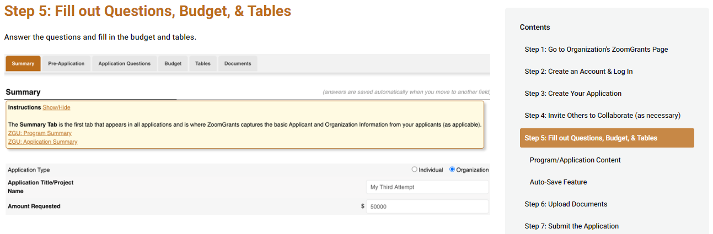
Apply Using ZoomGrants (cont.)

Slide 30
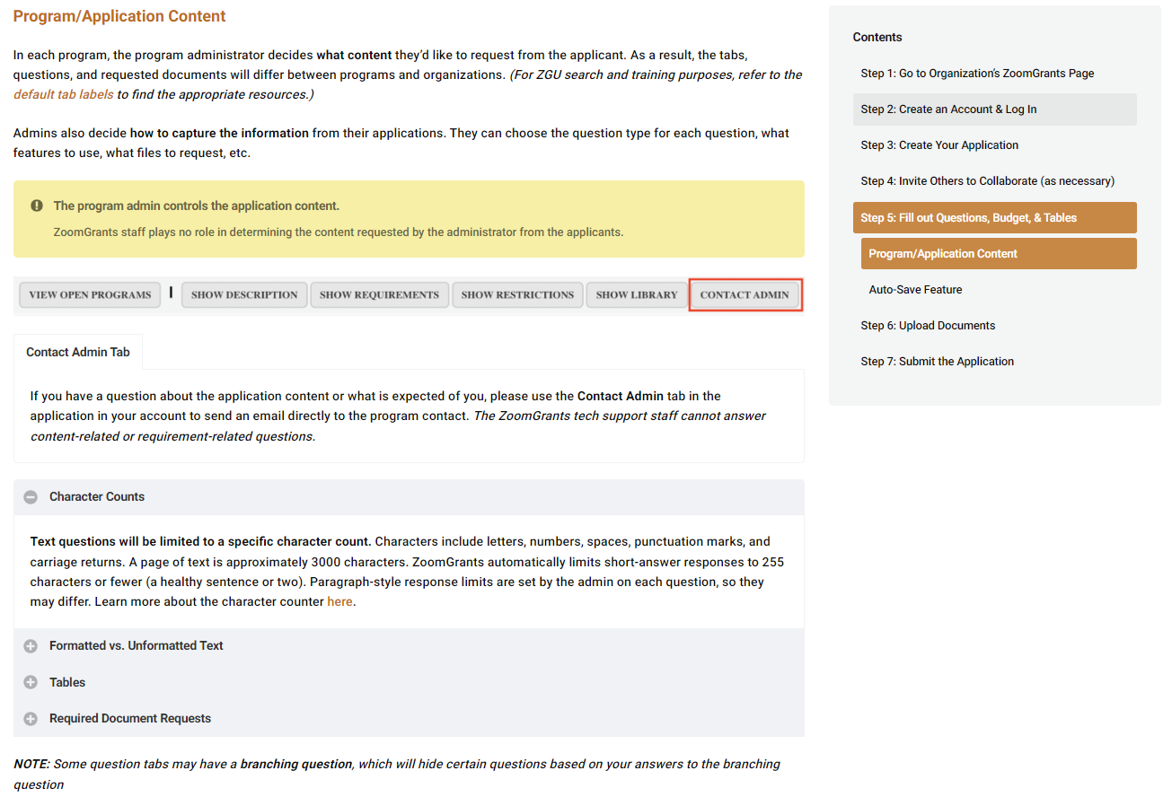
Apply Using ZoomGrants (cont.)

Slide 31
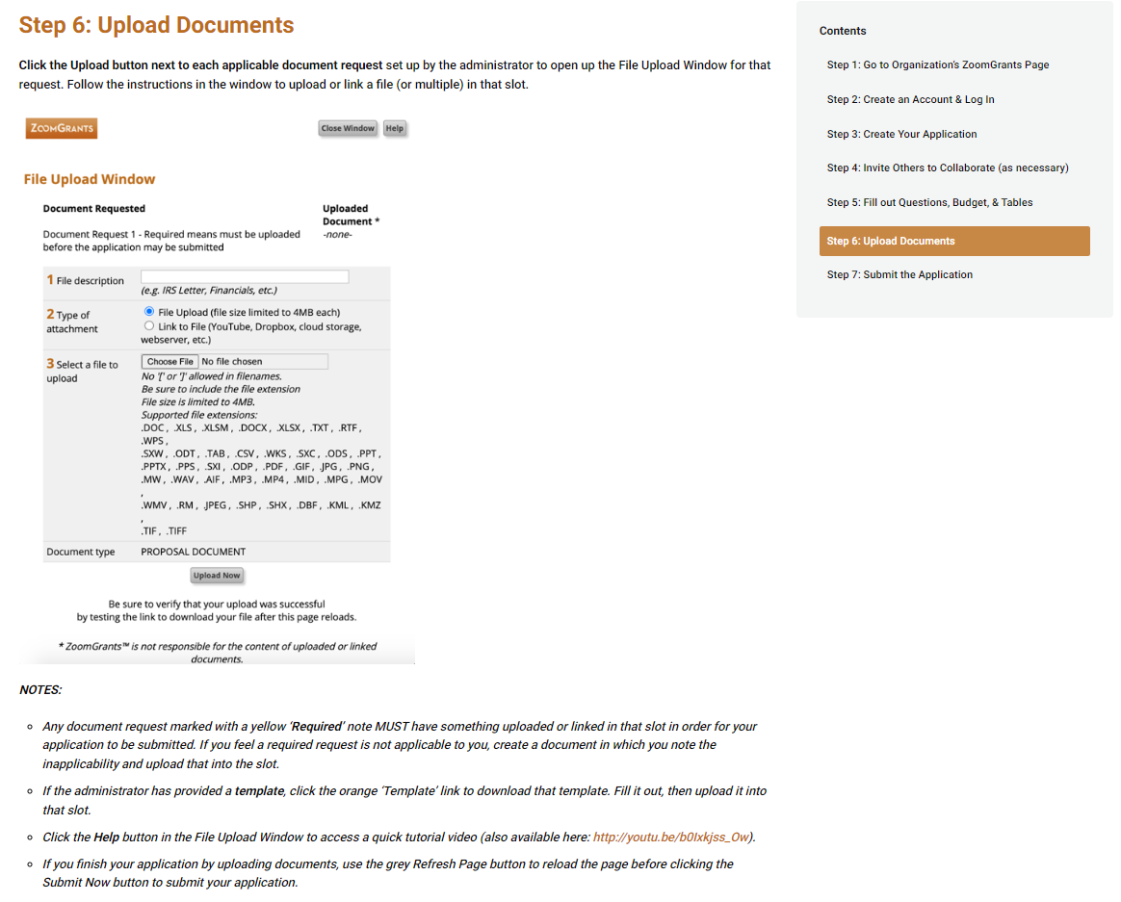
Apply Using ZoomGrants (cont.)

Slide 32
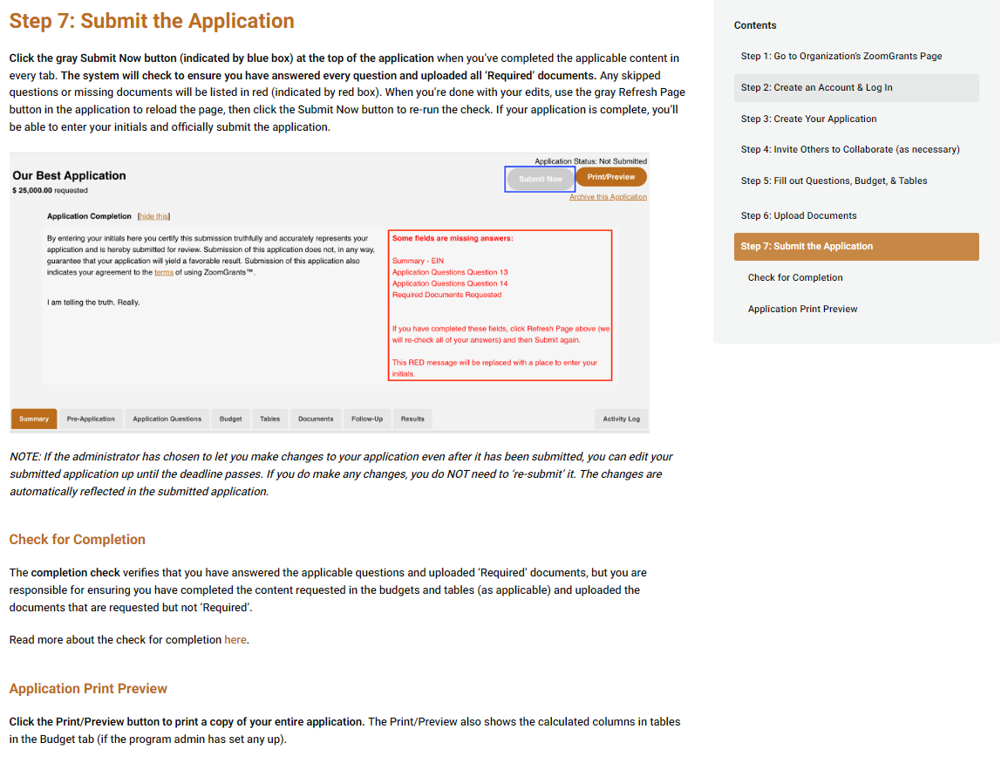
Apply Using ZoomGrants (cont.)

Slide 33
ZoomGrant Application Tips
Include documentation of Match funds as required by project application type.
Complete separate applications in ZoomGrants for each CDBG proposed project.
All applicants MUST register and submit the Notice of Intent in ZoomGrants.
Don’t wait too late to begin the application process! Technical difficulties with ZoomGrants submission can likely be avoided with timely completion and submission attempts.
Please allow a minimum of 1 week to complete the application. This does not include time to submit the application and update the required attachments.
Note that EVERY application question must have an answer.
Review CDBG Instructions before completing the CDBG application. Please reference it, or ask HCD staff for guidance to ensure your proposal meets the necessary criteria.
Review the CDBG application checklist to ensure all documents are completed and submitted with the application.

Slide 34
Important Things to Know About ZoomGrants​
When creating an account, ZoomGrants recommends using an admin email address or an email address that someone will maintain continuous access to.​
There is no 'Submission' button on the NOI. Just fill out the agency information in the Application Summary tab and then fill out the NOI tab. Once completed, it should allow you to automatically continue with the application.​
All documents from the previous paper application will be embedded in the application itself, OR they will be available to upload as an attachment in the Documents tab.​
All ZoomGrants users will have access to ZoomGrants University for assistance, or users can contact staff during the technical assistance period.​

Slide 35
FY26 CDBG Application
Application Key Components
Application Summary
Timeliness (Past Performance)
Consolidated Plan Goals and National Objectives
Project Narrative
Outcomes and Performance Measurements
Community Involvement and Collaboration
Organization and Staff Ability
Financial Ability
Budget
Housing Counseling Supplemental Application (if applicable for PS activities)
Checklist and Attachments

Slide 36
Required Certifications
Conflict of Interest
Good Standing with Athens-Clarke County Government
Drug Free Workplace
Anti-Lobbying
Section 3

Slide 37
Required Attachments
Programmatic Risk Assessment
CDBG Equity Assessment
MOUs/MOAs or Letters of Support
IRS Form 990, if applicable
Federal Tax Exemption Determination Letter, if applicable
Audited Financial Statement or Most Recent
Financial Audit
Site Control (AH or PFI projects)
Applicant Certifications
Photographs and/or Testimonial about your program

Slide 38

Project Narrative
Use data, including past performance success, former reports (Envision Athens, Athens Wellbeing, etc.) and available strategic plans, to support the need for your proposed program!
Clearly describe how your project addresses a Consolidated Plan Goal and National Objective. Don’t hesitate to contact HCD staff if you need clarification on these goals and objectives!
Address all parts of the Project Narrative application question to clearly outline how your project will be carried out from start to finish.
  Clearly identify the program target population, how participants will be selected, outreach efforts, specific services offered, frequency of service delivery, cost to benefit ratio, how many individuals will be served, etc.
  Do not approach the application as if information about your agency is already known. Many reviewers may know very little about you or your program, so it’s important you tell your story!

Slide 39
Performance Measures & Outcomes
Defining your Measures is a two-step approach:
  1. Specify your performance target area.
  2. Define a level of performance within that area.
Be S.M.A.R.T.
Specific
Measurable
Attainable
Realistic
Time-based
HCD staff can assist you in understanding how to formulate performance measures during the technical assistance period.

Slide 40
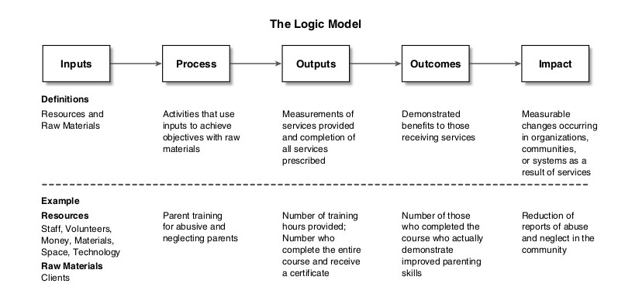
Performance Measures & Outcomes
Outputs vs. Outcomes

Slide 41
Organizational Ability and
Project Management
Focus on your organization’s experience managing federal, state, or local grant funds.
Managing a federally-funded program requires significant time for administrative, financial, and reporting activities.
HCD wants to know you have the ability to manage these funds successfully.
If your agency currently provides a meal delivery service for older adults, but your application is proposing a new group therapy program, it’s important to explain how your organization plans to carry out that proposed activity (i.e. staff member is a licensed mental health professional and has three years of experience providing group and individual therapy to older adults).
Describe your organization/staff’s ability to carry out your proposed program.

Slide 42
Project Budget
The budget is a great place to start when writing your CDBG application for funding.
If your budget includes ineligible line items, your CDBG application may be disqualified.
Cash payments in the form of stipends are not eligible line items.
No more than 20% of your CDBG budget may be used for program administrative costs.
Budgets and performance measures must be appropriate and realistic.
HCD staff can provide technical assistance regarding your proposed CDBG project budget.

Slide 43
Equity Assessment
Equity means justice, fairness, and including the different lived experiences, backgrounds, and needs of individuals and groups in policies and practices in order to close the gaps and improve outcomes.
Equity commits to taking consistent action to identify and close gaps in order to increase positive outcomes throughout our community. Equity implements policies and procedures to ensure fair treatment and access to resources. Equity evaluates and assesses the impact of our policies on residents to ensure we respond to populations based on specific identified needs rather than assumptions.
The Equity Assessment lays out a process and a set of questions to assist, guide, and address the impacts of decision-making through an equity lens. Equity requires the evaluation of policies and procedures to ensure the identification and elimination of disparities while moving towards a future where identity is no longer a predictor of outcomes.

Slide 44
Important Things To Consider
Minimum insurance requirements for CDBG contracting:
Fidelity Bond or Commercial Crime Insurance Coverage
Workers Compensation Coverage
General Liability Coverage
Excess/Umbrella Coverage
Auto Coverage or non-owned/hired coverage under general liability
Ability to complete activities through the reimbursement process
CDBG awarded projects do not receive up-front funding to begin program operations. You must be able to “float” operations and request reimbursement for costs incurred throughout the grant year.

Slide 45
Insurance Coverage Requirements
Fidelity Bond or Commercial Crime Insurance Coverage including:
Amount of coverage equal to or greater than CDBG award
Coverage extends for entire fiscal year
ACC Government listed as additional insured or loss payee
Endorsement page
30-day notice to ACC HCD of cancellation
A statement from the agency board president confirming that all employees handling CDBG funds disbursed under this contract are covered by fidelity or commercial crime insurance.
Listed insurer shall have an AM Best rating of “A” or higher.

Slide 46
Insurance Coverage Requirements (cont.)
Evidence of Workers Compensation Coverage from your agency’s insurance company:
Workers’ Compensation/ Employers Liability Coverage – Statutory/ $1,000,000.00 bodily injury by accident/disease each accident and each employee
Coverage shall also include a waiver of subrogation endorsement. If your agency is exempt from this coverage by Georgia state law, a letter of explanation may be submitted on the company’s letterhead and signed by the President of the Board.
Listed insurer shall have an AM Best rating of “A” or higher.

Slide 47
Insurance Coverage Requirements(cont.)
Evidence of General Liability coverage of a minimum $1,000,000 per occurrence and $2,000,000 per aggregate.
Coverage shall list the Unified Government of Athens-Clarke County as the additional insured and include a waiver of subrogation endorsement.
Endorsement Page
Listed insurer shall have an AM Best rating of “A” or higher.
Evidence of Excess/Umbrella coverage of a minimum $1,000,000 per occurrence and $2,000,000 per aggregate

Slide 48
Insurance Coverage Requirements (cont.)
Evidence of Auto coverage of a minimum $1,000,000 per occurrence and $1,000,000 per aggregate.
Coverage shall list the Unified Government of Athens-Clarke County as the additional insured and include a waiver of subrogation endorsement.
Listed insurer shall have an AM Best rating of “A” or higher.
  Note: For agencies that do own autos, coverage is extended through general liability

Slide 49
Insurance Coverage Enhancements (depending on project scope)
Other possible insurance requirements
Increased Limits
Builders Risk Policy
Environmental Coverage
Medical Malpractice Policy
Sexual Abuse/Molestation Coverage
Professional Policy

Slide 50
CDBG Application Staff Rating Criteria
100 Total Points
Project Narrative 25 Points
Outcomes and Performance 20 Points
Community Involvement and Collaboration 10 Points
Organization and Staff Ability 20 Points
Financial Ability 25 Points

Slide 51
Vision Committee
Application Rating Criteria
40 Total Points
Equity Assessment Evaluation 20 Points
High Priority Project 20 Points
Applications have the potential to receive an overall,
combined score of 140 points.

Slide 52
CDBG Application Tips
CDBG Activities must meet a National Objective and HCD Consolidated Plan Goal.
Most housing counseling and job training programs are public service activities, not affordable housing or economic development activities.
Economic development project activities carried out by a CBDO are limited to participants within the approved service area.
Include leveraging funds in Affordable Housing, Economic Development, and Public Facilities and Improvements project applications.
Don’t wait too late to begin the application process! Technical difficulties with the ZoomGrants online application site can likely be avoided with timely completion and submission attempts.
A technical assistance meeting with HCD staff is required to apply for any
Economic Development or Public Facilities and Improvements project application.

Slide 53
FY26 CDBG Schedule
Notice of Intent Due October 25, 2024
CDBG Applications Due November 18, 2024
Vision Committee Meeting February 3, 2025, 9:30am to 12:30pm
Mayor & Commission Work Session March 11, 2025
Agenda Setting Meeting April 15, 2025
Mayor and Commission Voting Meeting May 6, 2025
Initiate Contracting May 2025*
FY25 CDBG Funding Available July 1, 2025
*Dependent upon HUD notification of CDBG and HOME funding allocations

Slide 54
Application Technical Assistance
Affordable Housing and Economic Development
Marqueta Swain, marqueta.swain@accgov.com, ext. 6026
Solomon Smothers, solomon.smothers@accgov.com, ext. 6016
Hannah Savard, hannah.savard@accgov.com, ext. 6017
Public Facilities and Improvements
Marci Irwin, marci.Irwin@accgov.com, ext. 6023
Public Services
Damario Squire, damario.squire@accgov.com, ext. 6027
Lily Sronkoski, lillian.sronkoski@accgov.com, ext. 6142
Samantha Gambuti, samantha.gambute@accgov.com, ext. 6019
CDBG Technical Assistance period is between October 17- November 1, 2024. Please do NOT hesitate to contact us with questions.
For assistance call HCD staff at
(706) 613-3155

Slide 55

Questions?

