Slide 1


Athens-Clarke County ARPA Funding Guide
Presented by the ACCGov ARPA Administration Team at the
Housing & Community Development Department, Geospatial Information Office, and Inclusion Office
January 23, 2024

Slide 2
Purpose
The information in this Subrecipient presentation is provided for use by all Subrecipient staff receiving ARPA grant funds administered by ACCGov. This presentation is to serve as reference for the financial and programmatic requirements and responsibilities of projects funded through the ARPA CSLFRF program.
The financial, accounting, internal control, and reporting principles presented in this presentation are basic, and are not intended to replace acceptable existing procedures being used by your agency. Instead, these fundamental requirements represent minimum procedures and controls that must be embodied within your accounting, internal control, and financial reporting system as required by Federal regulations and ACCGov policies.

Slide 3
Agenda
Presenter Introduction
Introduction to ARPA in Athens-Clarke County
General Eligibility
General Provisions
Pre-Award Requirements
Post-Award Requirements
Cost Principles
Audit Requirements
Appendices Guide
Q&A – if time allows

Slide 4
Key ARPA Staff and Presenters Introduction
Alejandra Calva, Community Impact Administrator
Housing & Community Development
Coral Rogers, Compliance Administrator
Housing & Community Development
Cory Scott, ARPA Compliance Analyst
Housing & Community Development
Cameron McGlothen, Equity & Engagement Coordinator
Inclusion Office
Paige Seago, Data & Outcomes Coordinator
Geospatial Information Office
Yashaswini (Yashu) Kavalakuntla, Community Impact Specialist
Housing & Community Development

Slide 5
Introduction to ARPA in Athens-Clarke County

Slide 6
Introduction to ARPA
In March 2021, the American Rescue Plan Act of 2021 (ARPA) established the Coronavirus State and Local Fiscal Recovery Funds (SLFRF) to provide state, local, and Tribal governments with the resources needed to respond to the pandemic and its economic effects and to build a stronger, more equitable economy during the recovery.
The Treasury allocated $57.6 million to the Athens-Clarke County Unified Government. Funds may be used for costs incurred beginning on March 3, 2021, and must be obligated by December 31, 2024.
The contract provides that the period of performance will run until December 31, 2026 – all ARPA funds must be spent by this date.

Slide 7
ARPA in Athens-Clarke County
On March 1, 2022, the Mayor and Commission authorized the allocation of ARPA funds to the following goal areas (visit www.accgov.com/arpa for the most up-to-date information):
Affordable Housing: Create and preserve affordable housing in Athens-Clarke County. $15.0M total allocated. $744,517 Remaining (AJMP DPA RFP closed 1/16/24)
Youth Development & Violence Prevention: Develop safe, immersive, and inclusive programming to prevent violence and ensure that Athens-area youth social-emotional, educational, and developmental needs are met. $7.5M total allocated. $3.5M Remaining
Homelessness: To reduce and prevent homelessness in Athens Clarke County and strengthen the mental health and social service support systems for unhoused residents. $9.8M total allocated. $4.4M Remaining (RFP to be released by 1/31/24)
Business Development & Workforce Support: Support local business development and improve workforce wages & conditions. $4M total allocated. $4M Remaining
Behavioral Health: Emphasize behavioral health through program development and mental health resources. $4M total allocated. $0 Remaining

Slide 8
General Eligibility

Slide 9
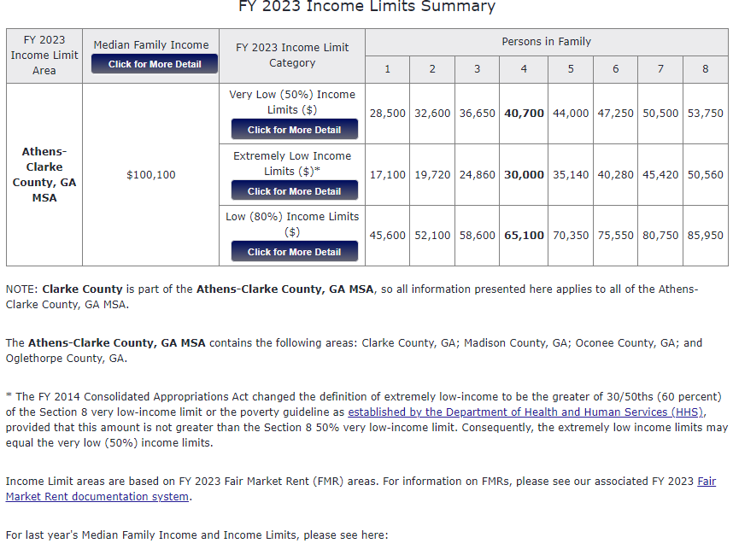
Household Income Limits
ARPA Low Income: 40% or less of Area Median Income (AMI)
ARPA Moderate Income: 65% or less AMI
All individuals and households receiving assistance must be 65% or less AMI, unless they reside in a Qualified Census Tract (QCT). The household income limit for QCT residents is 80% or less AMI.
There are no income limits for projects designated under Public Health.

Slide 10
Eligible Uses
ARPA Recipients and Subrecipients are responsible for ensuring each activity meets the eligibility requirements in the Treasury Final Rule for each statutory use below:
To respond to the COVID-19 public health emergency or its negative economic impacts;
To respond to workers performing essential work during the COVID-19 public health emergency by providing premium pay to eligible workers of the recipient that are performing such essential work, or by providing grants to eligible employers that have eligible workers who perform essential work;
For the provision of government services, to the extent of the reduction in revenue of such recipient due to the COVID–19 public health emergency, relative to revenues collected in the most recent full fiscal year of the recipient prior to the emergency;
To make necessary investments in water, sewer, or broadband infrastructure;
To provide emergency relief from natural disasters or the negative economic impacts of natural disasters;
For projects eligible under the 26 surface transportation programs specified in the 2023 CAA (Surface Transportation projects); or
For projects eligible under Title I of the Housing and Community Development Act of 1974 (Title I projects)

Slide 11
Restrictions on Use & Ineligible Uses
While recipients have considerable flexibility to use Coronavirus State and Local Fiscal Recovery Funds to address the diverse needs of their communities, the following restrictions on use of funds apply:
May not be used to offset a reduction in net tax revenue
May not be used to make deposits into pension funds
May not be used as debt service or to replenish financial reserves
May not be used to satisfy settlements and judgments
May not be used for a project that conflicts with or contravenes the purpose of the American Rescue Plan Act statute (e.g., uses of funds that undermine COVID-19 mitigation practices in line with CDC guidance and recommendations)
May not be used in violation of the Award Terms and Conditions or conflict of interest requirements under the Uniform Guidance.

Slide 12
Eligible Activities
ARPA-funded projects must fall under one of the Statutory Eligible Uses and should principally mitigate the effects of the pandemic, support families and businesses struggling with its public health and economic impacts, maintain vital public services, and build a strong, resilient, and equitable recovery by making investments that support long-term growth and opportunity.
Finally, projects must be consistent with the county’s goal areas and objectives as outlined in the introduction section of the resource guide.

Slide 13
General Provisions

Slide 14
Timeline for Use of ARPA Funds
ARPA funds may be used for costs incurred beginning on March 3, 2021, and must be obligated by December 31, 2024.
Most ACCGov ARPA contracts have a period of performance until December 31, 2026 – all ARPA funds must be spent by this date.

Slide 15
Administrative Expenses
Subrecipients may use funds for administering ARPA programs, including costs of consultants to support effective management and oversight, including consultation for ensuring compliance with legal, regulatory, and other requirements.
Subrecipients cannot use more than 10% of awarded funds on administration.

Slide 16
Recordkeeping Requirements
Accurate recordkeeping and reporting are crucial to the successful management of your ARPA-funded activities. Every subrecipient is required to establish and maintain at least three major categories of records:
Administrative Records: These are files and records that apply to the overall administration of the subrecipient’s ARPA activities. They include the following:
Personnel files.
Property management files.
General program files: files relating to the subrecipient’s application to the grantee, the Subrecipient Agreement, program policies and guidelines, correspondence with grantee and reports, etc.
Legal Files: articles of incorporation, bylaws of the organization, tax status, board minutes, contracts and other agreements.
Financial Records: These include the chart of accounts, a manual on accounting procedures, accounting journals and ledgers, source documentation (purchase orders, invoices, canceled checks, etc.), procurement files, bank account records, financial reports, audit files, etc.
Project/Client/Beneficiary Files: These files document the activities undertaken and eligibility with respect to specific individual beneficiaries, property owners, and/or properties.
The failure to maintain adequate documentation of ARPA-funded activities are one of the most serious administrative issues undermining program performance and regulatory compliance of subrecipients in the ARPA program.

Slide 17
Performance Reporting Requirements
Your agency is required to submit monthly or quarterly program Status Reports (as per your Subrecipient Agreement).
The purpose of this report is to demonstrate compliance with stated contract objectives and goals, measure progress toward those goals, and to justify the reimbursement of funds.
Monthly and financial reports are due on the 5th day of each month.
The report is one way to show the impact the funded program has on the community.
Visit www.accgov.com/arpa for Performance Measure Dashboards
from past and current ARPA-funded projects.

Slide 18
Federal Requirements in ARPA Programs
Limited English Proficiency
Debarment and Suspension List Verification
Code of Conduct
Recordkeeping Standards
Faith Based Activities
National Flood Insurance Program
Environmental Review
Displacement/Relocation
Lead-Based Paint

Slide 19

Questions

Slide 20
Pre-Award Requirements

Slide 21
Proposal Application & Evaluation Process
At the beginning of the ARPA Application process, HCD may hold a pre-application technical assistance meeting to review the procedures to be followed in the planning and preparation of grant applications. Upon the receipt of all ARPA applications, HCD staff determines eligibility and then rates and ranks the applications based upon the evaluation rubric provided with each Request for Proposal (RFP).
While HCD completes its internal application evaluation process, staff may present application packets to the ACCGov Citizen Advisory Committee (Vision Committee), other ACCGov Advisory Boards, as appropriate, or ACCGov staff from other departments, to be reviewed and rated. Upon completion of the application review process, staff and advisory committee members submit their prioritizations and review forms to HCD.
HCD then combines the ratings received and prepares funding recommendations then works with the ACCGov Manager to submit these recommendations for the Mayor and Commission’s consideration. Elected officials then have an opportunity for discussion, to receive clarifications from HCD staff, and make the final vote on awards made.

Slide 22
Financial Management Requirements
The purpose of financial management requirements is to ensure that a subrecipient agency receiving federal funds has a financial management system that will:
Provide effective control for all funds, property and other assets.
Identify the source and application of funds for federally sponsored activities; and
Permit the accurate and timely disclosure of financial results in accordance with the reporting requirements of the Uniform Guidance and ACCGov.

Slide 23
Equity Requirements
ARPA equity requirements are founded in the Treasury SLFRF Final Rule (Final Rule) Reaching Underserved Communities, which designates additional eligible uses for disproportionately impacted communities. Furthermore, prioritizing disproportionately impacted communities is in-line with Executive Order 13985, ‘‘Advancing Racial Equity and Support for Underserved Communities Through the Federal Government.” All use of SLFRF funds must comply with federal civil rights and nondiscrimination requirements, which include prohibitions on discrimination on the basis of race, color, national origin, sex, (including sexual orientation and gender identity), religion, disability, or age, or familial status.
ACCGov’s equitable development approach is an intentional approach to recognize ARPA projects that respond to community needs, give communities a voice in shaping the futures of their neighborhoods, provide community benefit, and contribute to the wellbeing of residents and the local economy surrounding the development.

Slide 24
Equity Requirements cont.
To ensure ARPA funded projects are equitable subrecipients should:
Provide clear and detailed results and outcomes that outline the effectiveness and impact of their proposed impact on the community. Proposals should identify what community need(s) are being met.
Provide clear detail and evidence on how community members and stakeholders were engaged in the developed of the proposal. These details should include information on the engagement methods and outcomes used during the development process as well as the feedback they received from the community.
Provide clear detail on the impact of the proposed project or program will have on the community.
Provide a clear and detailed analysis and strategies used for advancing opportunity and/or minimizing the negative or unintended outcomes for the said proposal on the community.
Provide a clear and detailed plan for implementation of the proposal. That should include a meaningful investment of resources for support staff and clearly outlines what is needed to effectively implement the proposed project.
Provide clear and detailed data that supports the proposal. The proposal should detail how the subrecipient will use the data, it should outline the gaps in data, and how the data was disseminated.
Provide clear detail on how the subrecipient will ensure accountability, communicate, and evaluate the results of the proposed project or program. The proposal should also detail how the subrecipient will continue to communicate, partner, and sustain relationships in the community around the proposal’s impact after funds have been awarded.

Slide 25
Additional ACCGov Equity Requirements
Affirmatively Furthering Fair Housing
Integration and Accessibility
Reasonable Accommodations and Modifications for Person with Disabilities
Discrimination Based on Household Composition
Preventing Involuntary Family Separation
Equal Access in Accordance with Gender Identity
Prioritized Subpopulations and Fair Housing Implications
Section 504/Accessibility
Equal Employment Opportunity

Slide 26
Post-Award Requirements

Slide 27
The federal regulations provide specific requirements in the following areas: internal controls, accounting records, performance measurement, allowable costs, source documentation, budget controls, cash management, financial reporting and audits.

Slide 28
Program Income
Program income, as defined in 2 CFR 200.1, includes, but is not limited to, the following:
fees for services performed
the use or rental or real or personal property acquired under Federal awards
the sale of commodities or items fabricated under a Federal award
license fees and royalties on patents and copyrights; and
principal and interest on loans made with Federal award funds.
Program Income is NOT:
Interest earned on advances of Federal funds; and
Except as otherwise provided in Federal statutes, regulations, or the terms and conditions of the Federal award, program income does not include rebates, credits, discounts, and interest earned on any of the proceeding.

Slide 29
Program Budget
This section describes the various kinds of allowable program expenses applicable to each budget line item and specifies the appropriate documentation to submit in a reimbursement request.
Wages (all employees, including executive directors, regular employees and contract employees, paid in whole or in part with ARPA funds, are required to prepare weekly time sheets. The time log sheets must be signed by the employee and his or her supervisor.)
Contract Services (items such things as audit expenses, accounting services, professional counseling services, etc.)
Consultant Services (can be individuals who have their own companies, or independent firms, and are not carried on the subrecipient's payroll)
Space Rental (rental costs can be documented either as contract expenses or by submittal of invoices and copies of canceled checks on a monthly basis)

Slide 30
Program Budget (Continued)
Supplies (supply expenses shall be documented with itemized receipts supported by proof of payment (copies of canceled checks or debit withdrawals on bank statements).
Rental, Lease, or Purchase of Equipment (office equipment, such as file cabinets, office furniture, phone systems, and copiers; shelter equipment, such as, washing machines, refrigerators, and beds may be rented, leased, or purchased.)
Insurance (insurance payments can be documented with invoices and copies of canceled checks, as proof of payment. Late payment penalties are not eligible for reimbursement.)
Other (can include utilities, telephone, copying charges, cellular phone, internet fees, etc. )
Travel (all standards used must be in compliance with 2 CFR 200.475. Mileage reimbursement requests for travel must be accompanied by a mileage log report.)

Slide 31
Award Payment Process
Billing for Expenditure Reimbursement
Under your ARPA contract with ACCGov, payment of grant funds will be made through reimbursement of monthly expenditures and/or advanced payment. For those projects and programs operating on a reimbursement basis, even with an allocation of ARPA funds and an active contract, your agency will not actually receive the funds prior to an expenditure on your part.
Reimbursement
Subrecipients are required to use the grant management software Zoom Grants to complete the official reimbursement request forms provided by HCD staff. These forms will include the agency name, the reimbursement number, and budget for the current year of funding.
Zoom Grants Management System
HCD now uses Zoom Grants to manage all grant-funded projects. Your ACCGov grant manager will provide account access, training videos, and technical assistance with Zoom Grants once your contract with ACCGov has been executed.
Advanced Payment Process
Some ARPA funds are awarded on an advanced payment basis. In this case, the advanced payment schedule is included as part of your contract with ACCGov.

Slide 32
Subrecipient Monitoring
1. Ongoing Contract Supervision
2. Routine Desk Reviews
3. Onsite Monitoring Visits
Notification Letter
Entrance Conference
Documentation, Data Review, and Analysis
Exit Conference
Follow-up Monitoring Letter

Slide 33
Contract Modifications
Under the terms of ACCGov ARPA subrecipient contracts, there are two basic kinds of contract modifications that can be approved: Budget and Performance Measure Modifications.
ACCGov may, in its discretion, amend contracts to conform with Federal, state, or local governmental guidelines, policies and available funding amounts, or for other reasons.
If such modification(s) result in a change in the funding amount or the Scope of Services, these amendments must be approved by the ACCGov Mayor and Commission.

Slide 34
Questions?

Slide 35
Cost Principles

Slide 36
Allowable Cost
A cost is allowable if:
The expenditure is necessary, reasonable and directly related to the grant (2 CFR 200.403(a) and 2 CFR 200.404).
The expenditure has been authorized by ACCGov through approval of the budget for the activity in your contract (2 CFR 200.403(b)). The program budget will be outlined in the subrecipient contract for services; and,
The expenditure is not prohibited under federal, state or local laws or regulations; and,
The subrecipient applies generally accepted accounting principles in computing the cost (2 CFR 200.403(e)), utilizes the same procedures in calculating costs as for its non-federally assisted activities (2 CFR 200.403(c)), and costs are consistently applied as any other costs incurred for the same purpose in like circumstances (2 CFR 200.403(d)); and,

Slide 37
Allowable Cost (Continued)
It is properly documented (2 CFR 200.403(g)); and,
Proof of costs incurred (invoice, time sheet, lease agreement, itemized bill, etc)
Proof of payment (cashed check, ACH receipt, bank or credit statement, etc)
It is incurred during the approved budget period (2 CFR 200.403(h)); and,
The cost is allocable to the ARPA program (2 CFR 200.405). A cost is allocable to a particular cost objective (grant, program or activity) in proportion to the relative benefits received for that objective. This means that:
If an office is utilized by two programs during the same hours, the costs of the office should be allocated between the two programs on an equitable basis.
The same expense cannot be claimed against more than one grant (double billing is prohibited); and,
The cost is net of all applicable credits. Any credits such as purchase discounts or price adjustments must be deducted from total costs charged (2 CFR 200.406). The subrecipient is not allowed to make a profit from credits against any costs charged to ARPA funds.

Slide 38
Audit Requirements

Slide 39
Subrecipients are required to have an annual audit conducted of federal funds expended each fiscal year or face sanctions.
Subrecipients and contractors. An auditee may simultaneously be a recipient, a subrecipient, and a contractor. Federal awards expended as a recipient or a subrecipient are subject to audit under this part. The payments received for goods or services provided as a contractor are not Federal awards. Section 2 CFR 200.331 sets forth the considerations in determining whether payments constitute a Federal award or a payment for goods or services provided as a contractor. See 2 CFR 200.501(g) for the compliance responsibilities of contractors.

Slide 40
Audits must be conducted in accordance with the following:
Single or Program-Specific Audit Threshold (2 CFR 200.501). The single or program specific audit threshold as of December 2023 is $750,000 in federal expenditures. This means that all non-federal government agencies and nonprofit organizations that expend $750,000 or more in federal awards in a given fiscal year are required to conduct a single or program specific audit. See also 2 CFR 200.502 to determine federal expenditures and 2 CFR 200.507 for more detail regarding program specific audits.
Audit Findings (2 CFR 200.516). Auditors must report significant deficiencies and material weaknesses in internal controls, material noncompliance with the provisions of Federal statutes, regulations, or the terms and conditions of Federal award(s), known questioned costs that are greater than $25,000, and known or likely fraud affecting a Federal award. See also 2 CFR 200.514 for more details about the scope of a federal audit.
Audit Expenses. Any costs of auditing grantees or recipients that are not required to have a single audit are not allowable (2 CFR 200.506).
Auditee Responsibilities (2 CFR 200.508). Auditees must procure or otherwise arrange for the audit according to 2 CFR 200.509, prepare appropriate financial statements according to 2 CFR 200.510, promptly follow up and take corrective action on audit findings according to 2 CFR 200.511, and provide the auditor with access to personnel, accounts, books, records, supporting documentation, and other information as needed.
Audits must be conducted in accordance with Generally Accepted Government Auditing Standards (GAGAS) (2 CFR 200.514(a)).

Slide 41
Single Audit Exemptions:
Subrecipients who did not expend more than $750,000 of federal funds annually (2 CFR 200.501(d)).
For-profit subrecipients are not subject to federal audit requirements. However, HCD, as the pass-through entity, is responsible for establishing requirements to ensure compliance by for-profit subrecipients. These requirements and the for-profit's responsibility to maintain compliance will be described in your subrecipient agreement with ACCGov.

Slide 42
Subrecipient Guide Appendices

Slide 43
APPENDIX A: ARPA Program Resources
Treasury CLSFRF Final Rule
Final Rule FAQ
2023 Interim Final Rule
Uniform Guidance
ACCGov ARPA Data Hub
ARPA Income Limits

Slide 44
APPENDIX B: Contract Checklist
Scope of Services
Budget Form
Names & Signatures of authorized reimbursement
Board of Directors List
Insurance Requirements
Equity-based Requirements
GSIC/SAVE

Slide 45
APPENDIX C: Reimbursement Request Forms & Progress Reporting
ARPA reimbursement request/ expenditure form
Schedule of documentation
Program status report

Slide 46
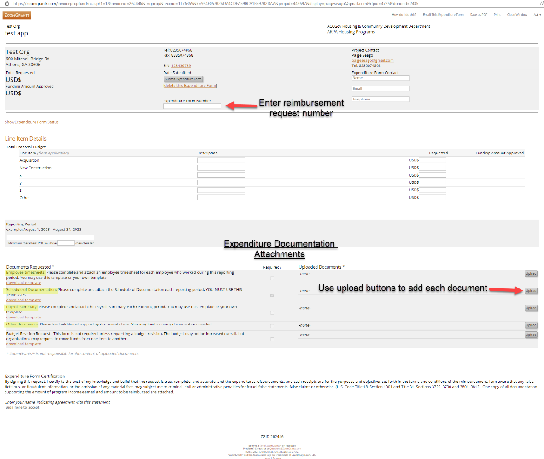
ARPA Reimbursement Request/ Expenditure Form

Slide 47
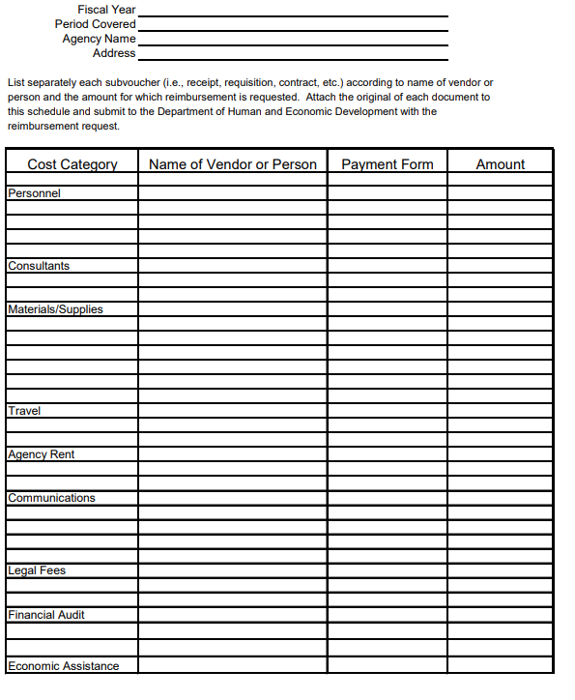
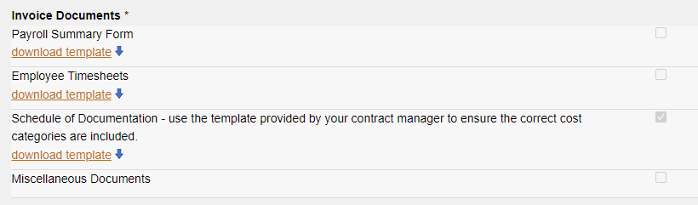
Schedule of Documentation

Slide 48
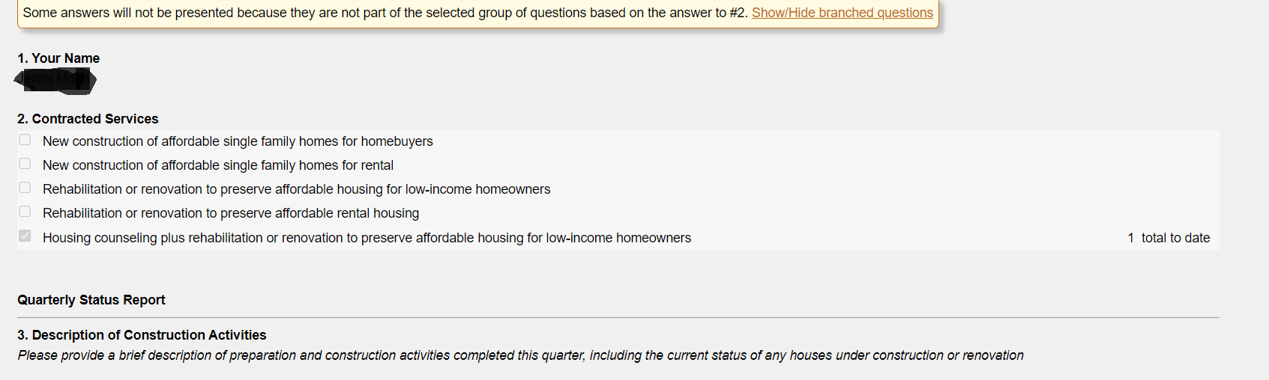
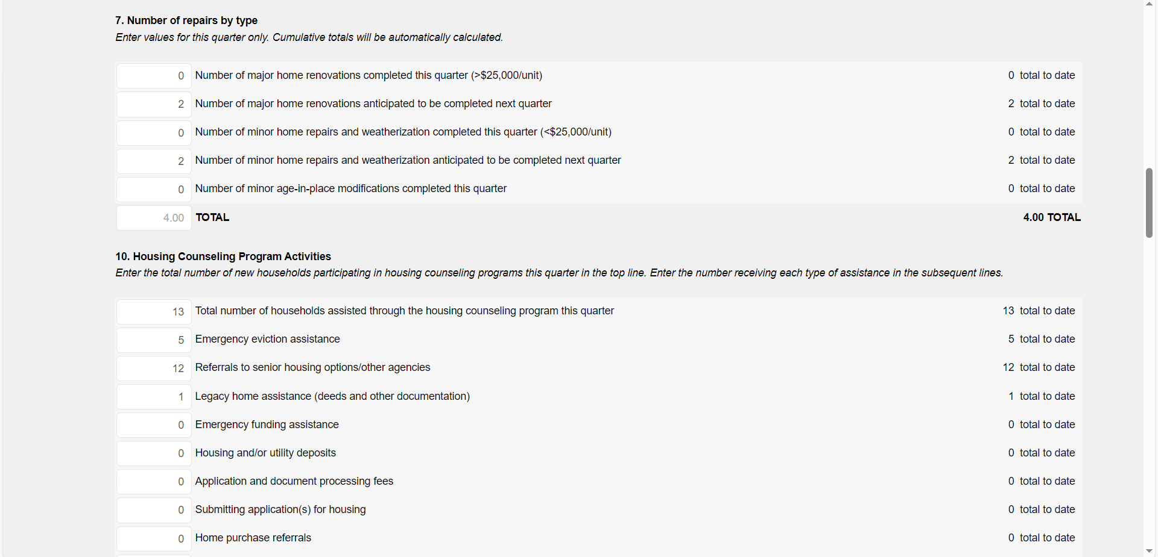
Program Status Report

Slide 49
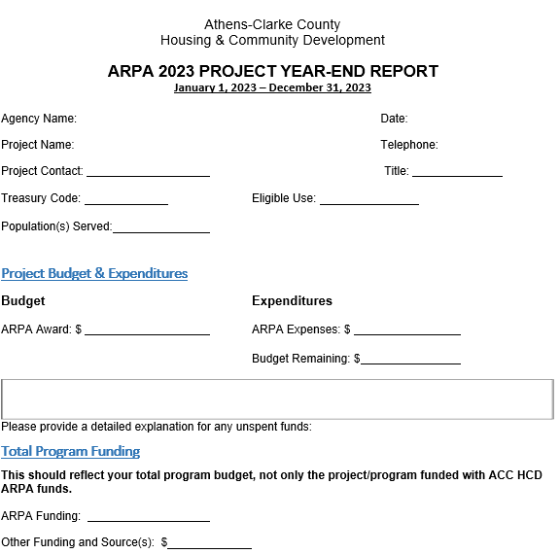
APPENDIX D: Year End Report

Slide 50
APPENDIX D: Monitoring Risk Tool and Checklist
APPENDIX E: ARPA Risk Assessment and Monitoring
ARPA Risk Assessment
Conflict of Interest Questionnaire
On-site Monitoring Form

Slide 51
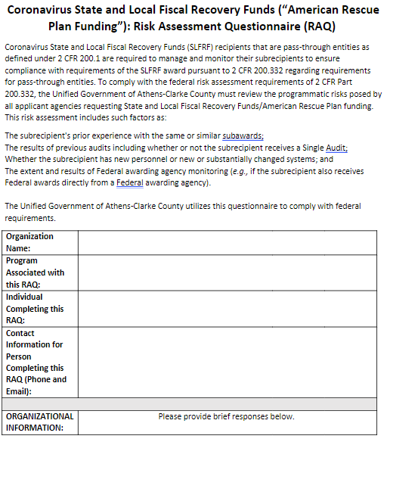
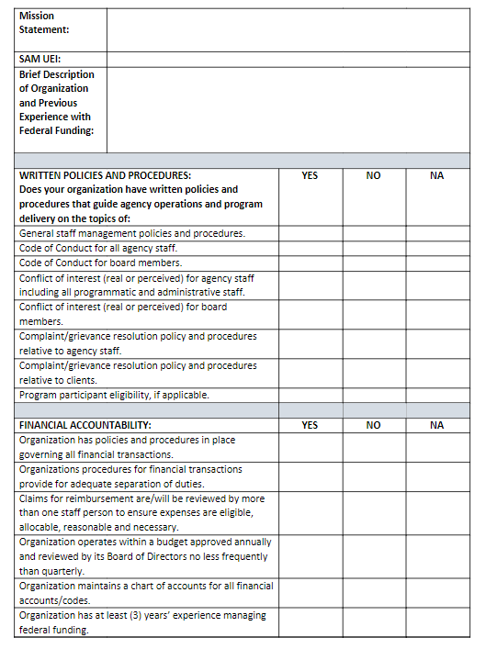
Risk Assessment

Slide 52
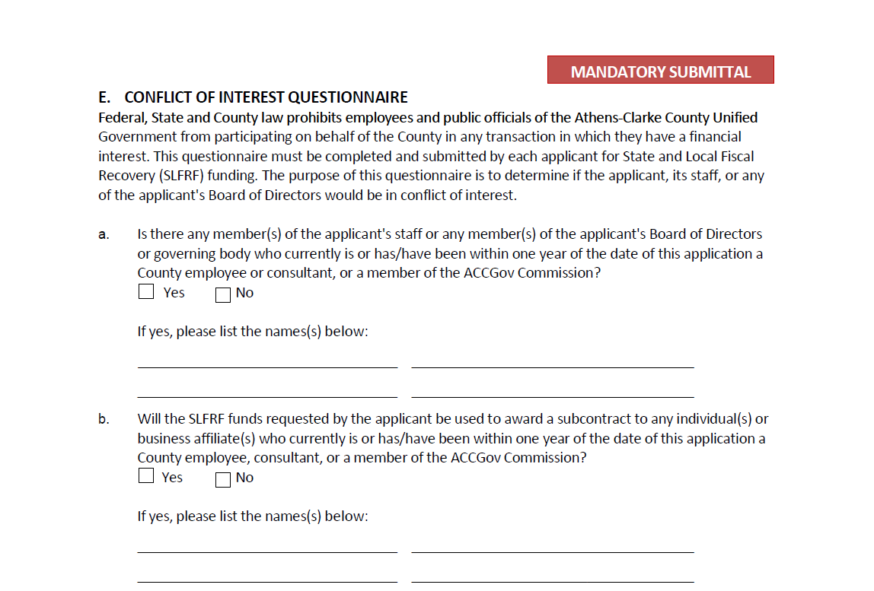
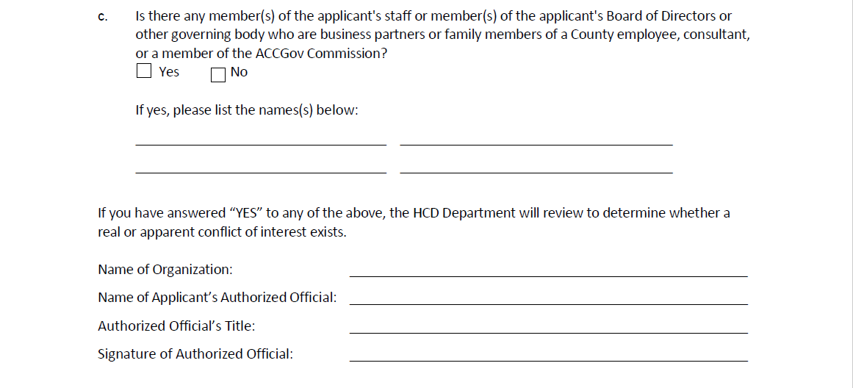
Conflict of Interest Questionnaire

Slide 53
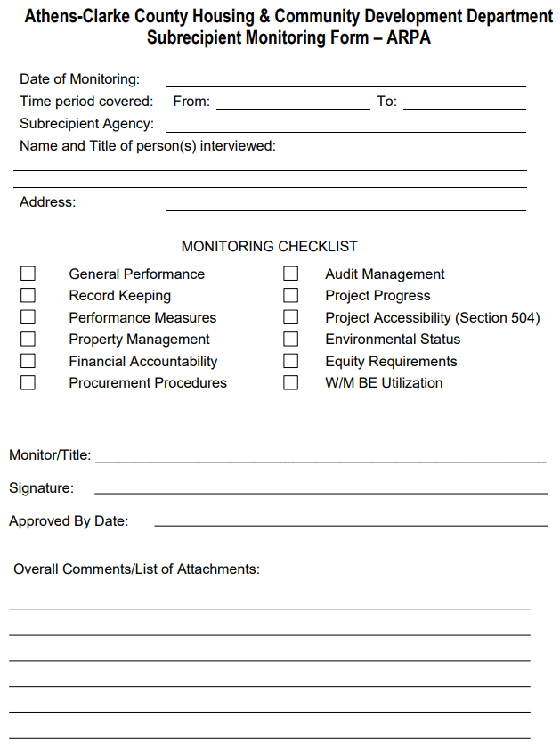
ARPA Monitoring Tool

Slide 54
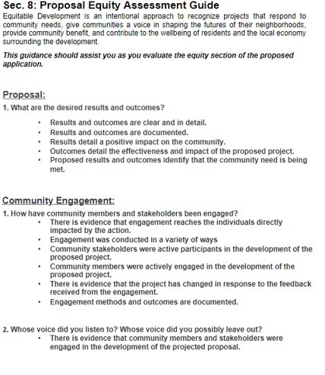
APPENDIX D: Monitoring Risk Tool and Checklist
APPENDIX F: Equity Assessment Guide

Slide 55
Questions?

